Slide 1

CSCI 4237
Software Design for Handheld Devices
Lecture 10 - Firebase: Database & Metrics
Mike Cobb

Slide 2
Upcoming
Today - Project 2 Proposals Due
1 week - 4/2 - Quiz 3 (no homework)
2 weeks - 4/9 - Project 2 Check-in #1
3 weeks -4/16 - quiz 4
4 weeks -4/23 -project 2 presentations

Slide 3
Quiz 2
Overall average : 26.5/30
Over 90%: 13/22

Slide 4
Project 2 - Proposals
If you choose to use Firebase Realtime DB (today’s lecture) in your project it counts as a complexity.
Highly recommend it

Slide 5
Last Time
Firebase
Authentication
Crashlytics
Analytics

Slide 6
Today
Project Ideas
Firebase
Realtime Database

Slide 7
Project 2 proposals
What is your base project concept
Why are you doing it
What are your two complexities

Slide 8
Uber App libraries

Slide 9
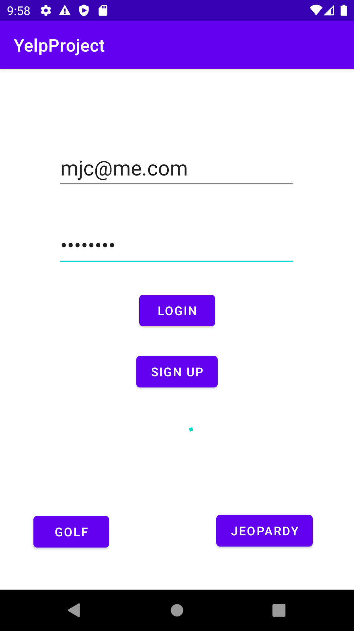
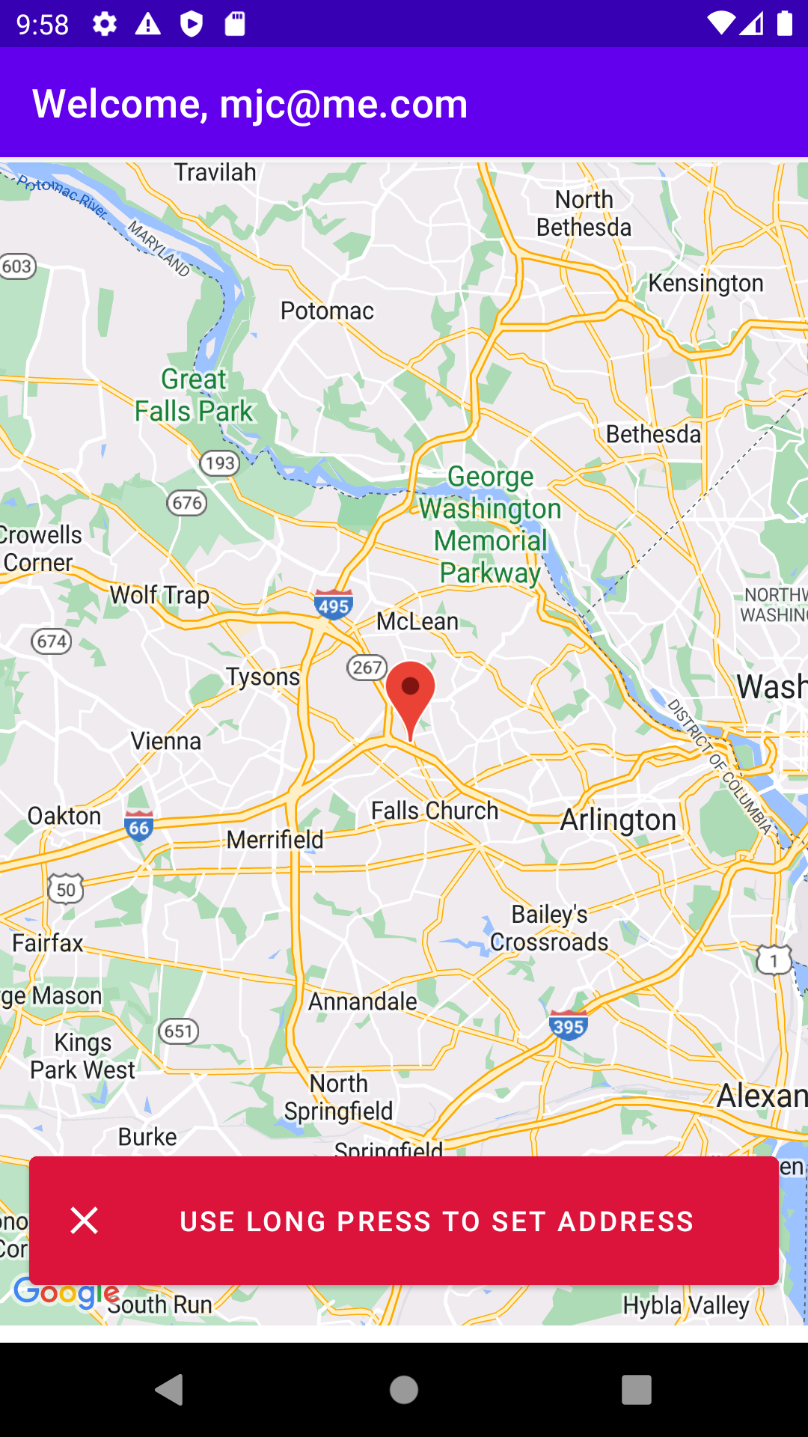
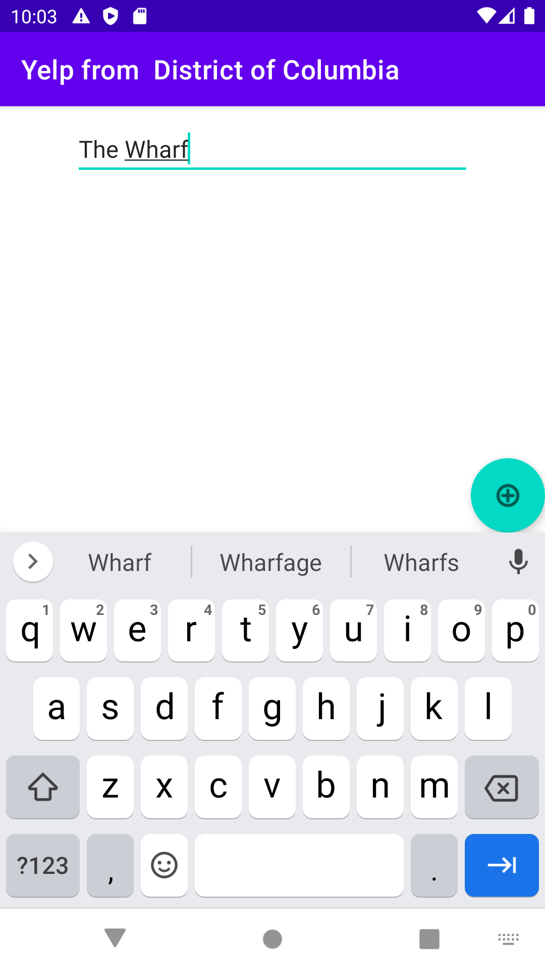
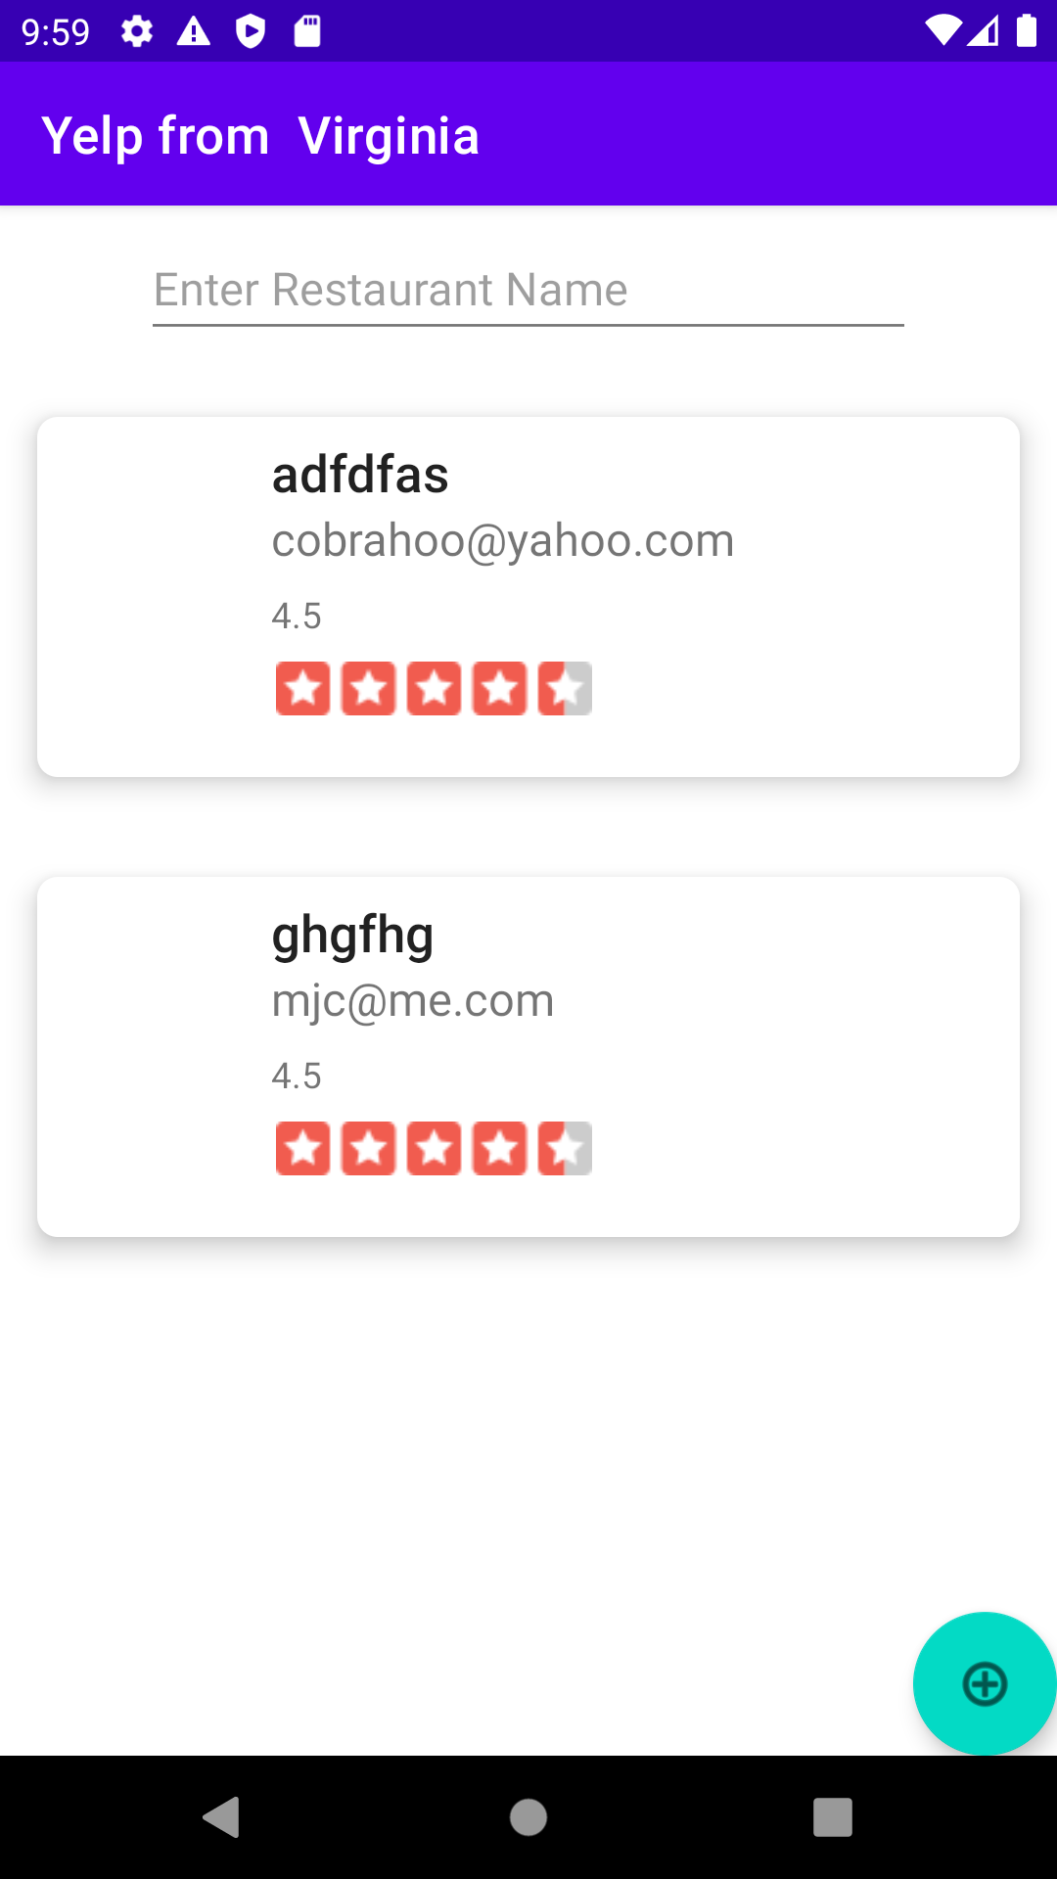
Demo of what we’re going to be building...

Slide 10
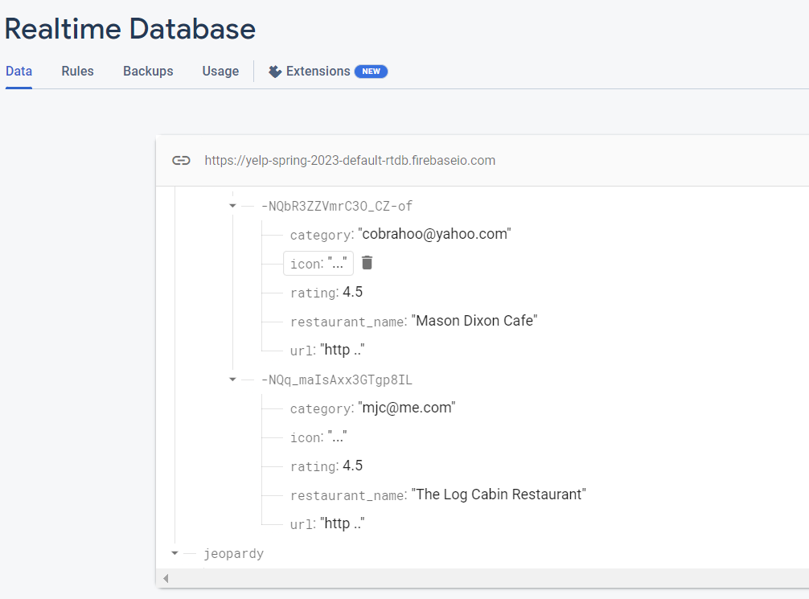
Demo of what we’re going to be building...

Slide 11
Firebase Realtime Database

Slide 12
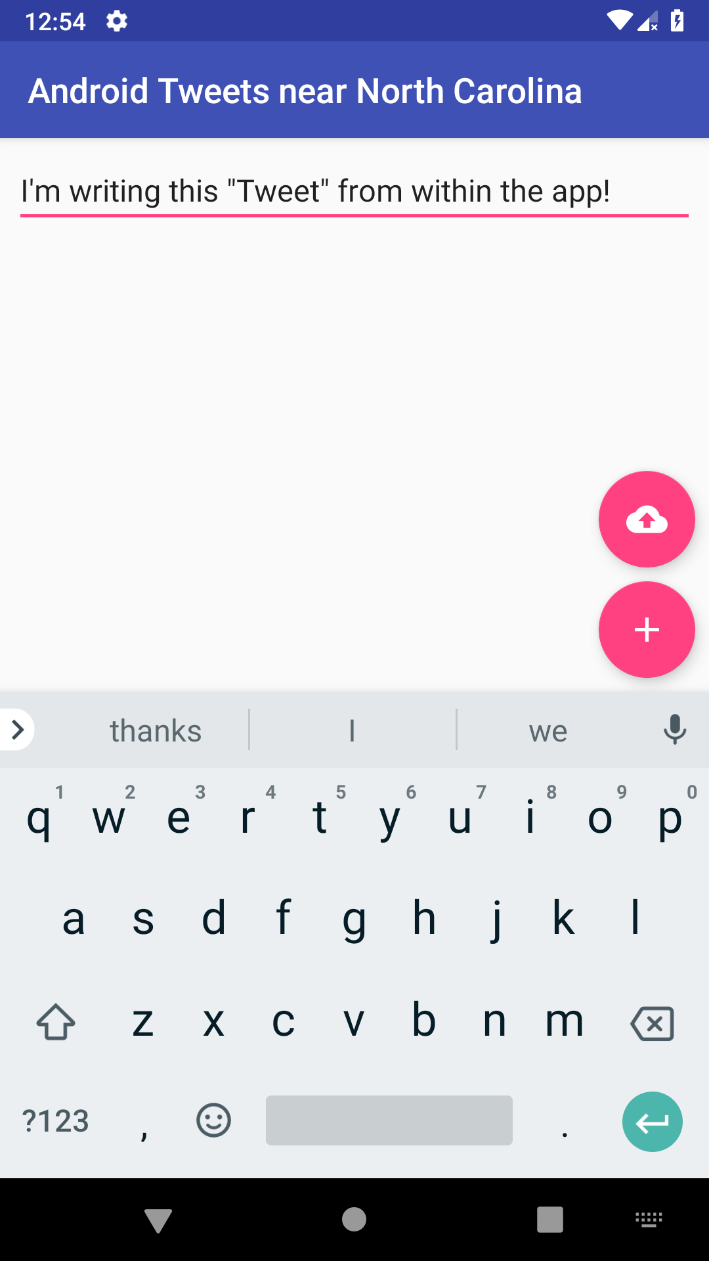
Writing to your Firebase Database
Let’s add an EditText and a FloatingActionButton to our YelpListings page.

Slide 13
Writing to your Firebase Database
The rounded button is called a “FloatingActionButton” (FAB), which works like an ImageButton.
// Part of the Design library
implementation 'com.google.android.material:material:1.5.0'

Slide 14
Writing to your Firebase Database
<?xml version="1.0" encoding="utf-8"?>
<androidx.constraintlayout.widget.ConstraintLayout xmlns:android="http://schemas.android.com/apk/res/android"
xmlns:app="http://schemas.android.com/apk/res-auto"
xmlns:tools="http://schemas.android.com/tools"
android:layout_width="match_parent"
android:layout_height="match_parent">
<EditText
android:id="@+id/tweet_content"
android:layout_width="0dp"
android:layout_height="wrap_content"
android:ems="10"
android:inputType="textPersonName"
android:hint="Write a Tweet!"
app:layout_constraintEnd_toEndOf="parent"
app:layout_constraintStart_toStartOf="parent"
app:layout_constraintTop_toTopOf="parent" />
<androidx.recyclerview.widget.RecyclerView
android:id="@+id/recyclerView"
android:layout_width="0dp"
android:layout_height="0dp"
app:layout_constraintBottom_toBottomOf="parent"
app:layout_constraintEnd_toEndOf="parent"
app:layout_constraintHorizontal_bias="0.0"
app:layout_constraintStart_toStartOf="parent"
app:layout_constraintTop_toBottomOf="@+id/editText" />
<com.google.android.material.floatingactionbutton.FloatingActionButton
android:id="@+id/add_tweet"
android:layout_width="wrap_content"
android:layout_height="wrap_content"
android:layout_margin="8dp"
android:clickable="true"
app:layout_constraintBottom_toBottomOf="parent"
app:layout_constraintEnd_toEndOf="parent"
app:srcCompat="@drawable/ic_add_white"
app:useCompatPadding="true" />
</androidx.constraintlayout.widget.ConstraintLayout>

Slide 15
So Firebase Database
What things do we need to do if we are going to add the database feature to our app?

Slide 16
Adding the dependencies
In the app’s build.gradle add the Firebase DB dependency:
dependencies {
… implementation platform('com.google.firebase:firebase-bom:...')
implementation 'com.google.firebase:firebase-database-ktx'
}

Slide 17
Firebase Database
We’re going to be using the “Realtime Database” option, instead of the newer “Cloud Firestore” (which recently came out of beta).
Comparison of the two

Slide 18
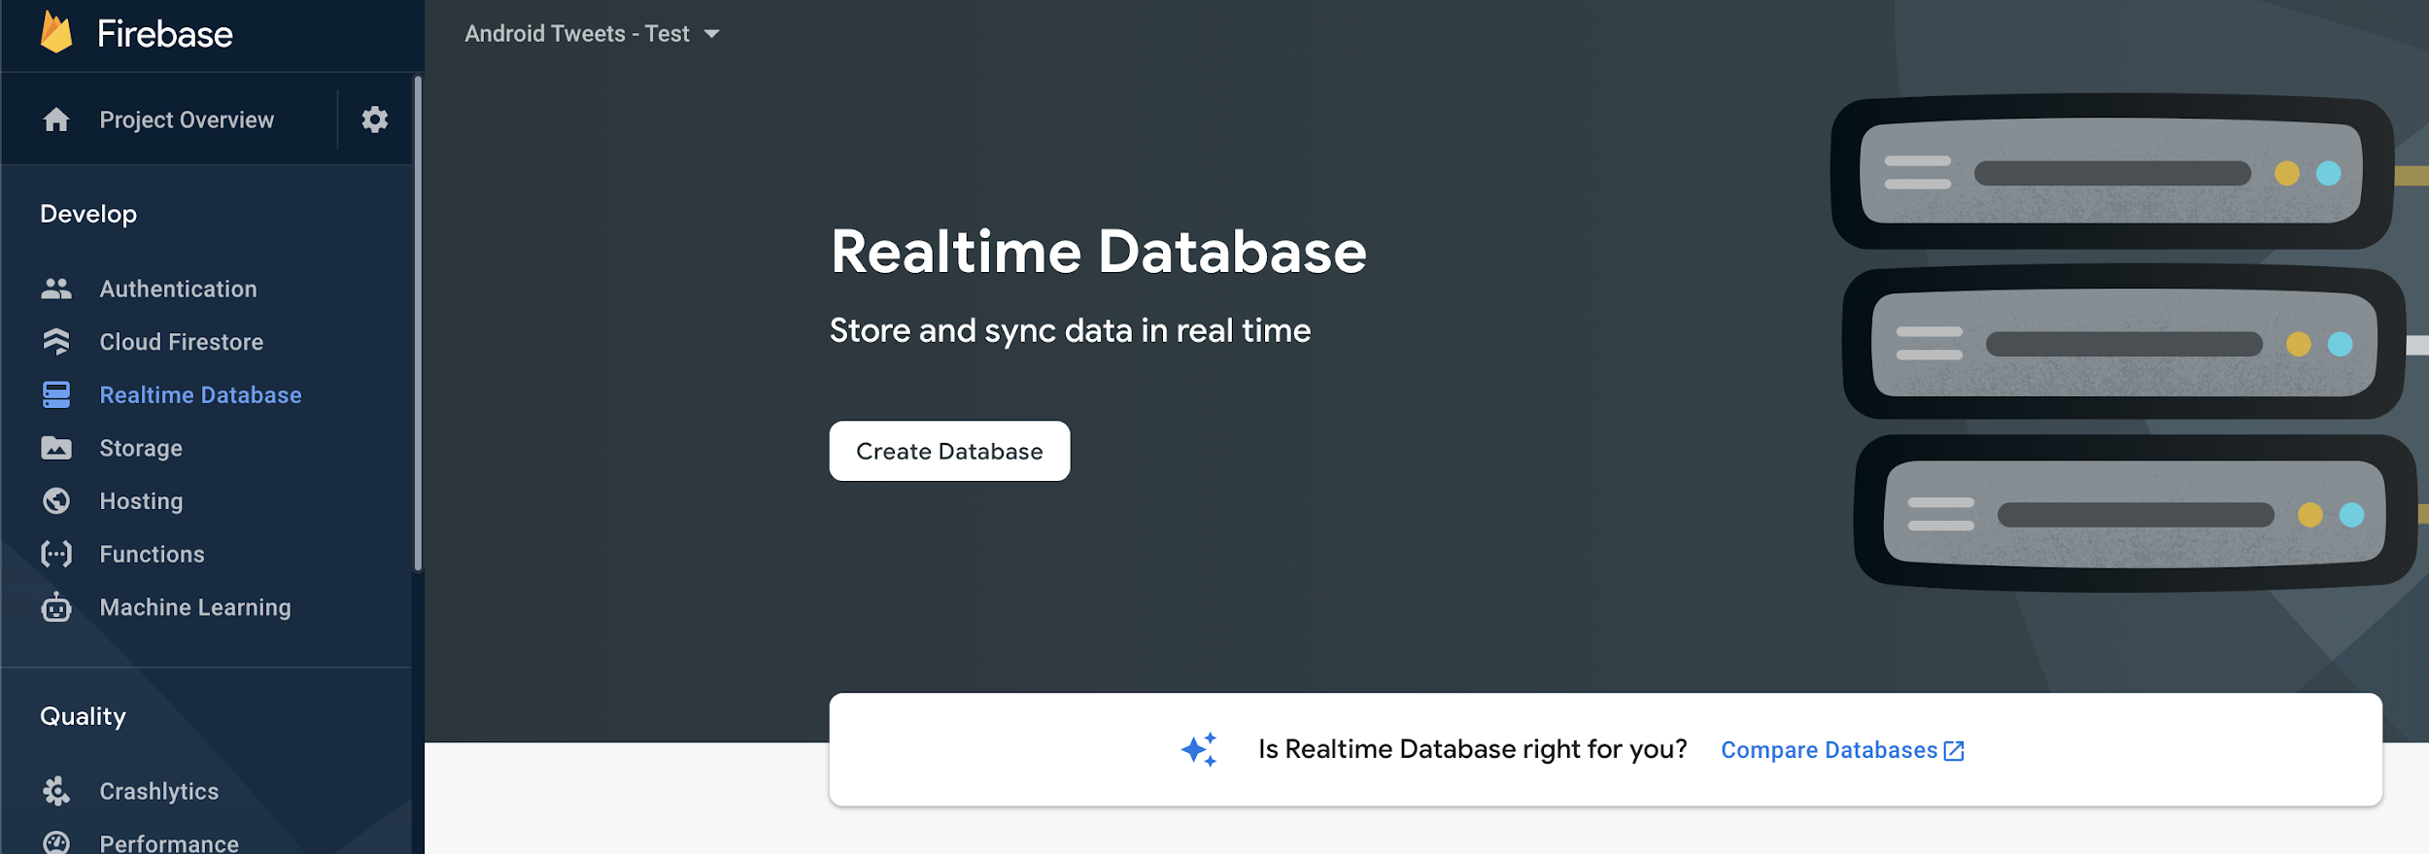
Firebase Database
We’re going to be using the “Realtime Database” option.

Slide 19
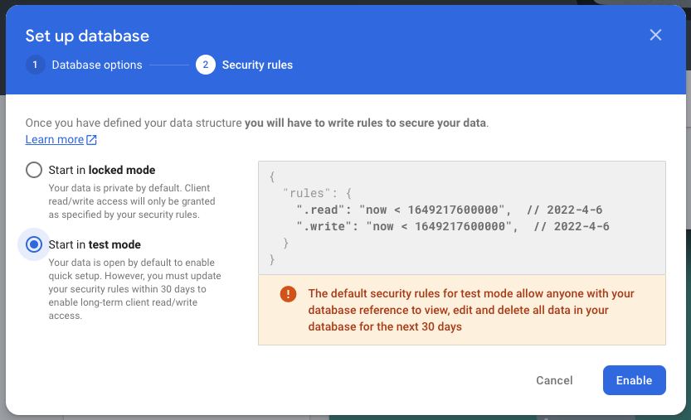
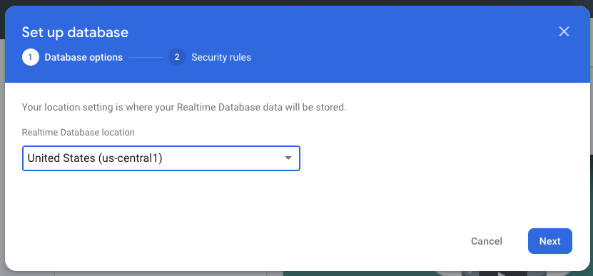
Firebase Database
Start in “test mode” - to allow read & write capabilities (by default for 30 days, but can modified for more).

Slide 20
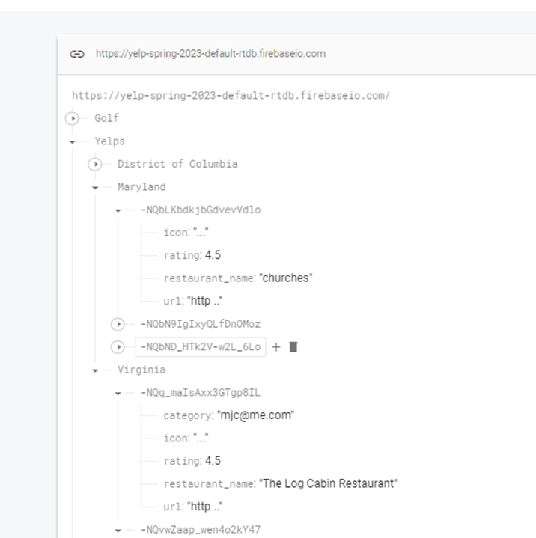
Firebase Database
Instead of being SQL-based with tables, Firebase’s database are JSON based.

Slide 21
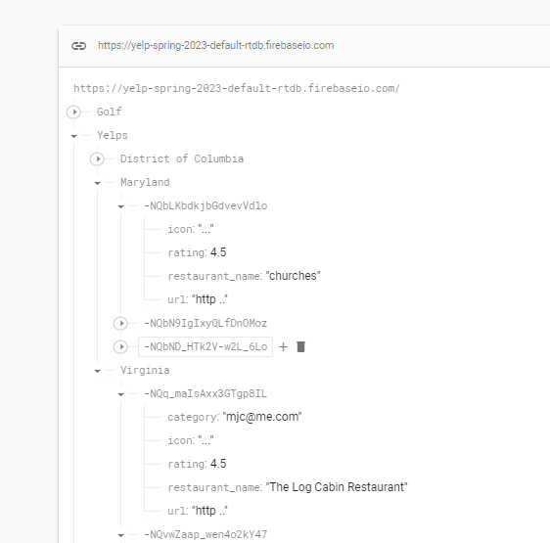
Firebase Database
We’ll have “tables”, based on which state the user selects on the Map.
“Yelp businesses” can be written and posted to that state in the database.

Slide 22
Writing to your Firebase Database
We need two things to write to the database:
The “path”, e.g.: “yelps/New York”
The data (our Yelp Business Class).

Slide 23
Writing to your Firebase Database
We’ll move our Yelp code into its own function, so we can swap between the Yelp API vs. Firebase when needed.
//getYelpData(address) from Yelp getYelpFromFirebase(address)

Slide 24
Writing to your Firebase Database
First, get an instance to the database SDK:
private lateinit var firebaseDatabase: FirebaseDatabase
override fun onCreate(savedInstanceState: Bundle?) {
super.onCreate(savedInstanceState)
setContentView(R.layout.activity_tweets)
firebaseDatabase = FirebaseDatabase.getInstance()

Slide 25
Getting the US State
We already have the Address object in the YelpsListingActivity. The US State is kept in the “adminArea” field.
val address: Address = intent.getParcelableExtra("address")!!
// The field is nullable, so we'll have a default, though it shouldn't be for US locations.
val state = address.adminArea ?: "unknown"

Slide 26
Writing to your Firebase Database
We’ll also put the Firebase DB code in its own function.
private fun getYelpDataFromFirebase(address: Address) {

Slide 27
Writing to your Firebase Database
We next need the “path” in the DB where we want to write data.
For example, “Yelps/Maryland” This is called a “reference”.

Slide 28
Writing to your Firebase Database
In code, you call getReference(...) and pass it the path name you want to read or write to.
val state = address.adminArea ?: "unknown"
// Point to tweets/<state> in our database.
// It’s okay if it doesn’t exist yet,
// Firebase will create it when we push data.
val reference = firebaseDatabase.getReference(“yelps/$state")

Slide 29
Writing to your Firebase Database
Call setValue(data) on your reference to write data to that location. We’ll use what the user typed in the EditText too.
addYelp.setOnClickListener{ val businessName=yelpName.text.toString() //create a YelpBusiness object val email= FirebaseAuth.getInstance().currentUser!!.email!! val yelp=YelpBusiness( restaurant_name = businessName, category=email, url="http ..", rating=4.5, icon="..." ) val reference=firebaseDatabase.getReference("Yelps/$state") reference.setValue(yelp) } }

Slide 30
Writing to your Firebase Database
Note -- setValue(...) always overwrites data at your reference.
This is good for single pieces of data, but not for lists where we’d want to append.

Slide 31
Writing to your Firebase Database
We could use .child(“some name”) to write as a child node of our reference… if we had some suitable name in mind (like an ID).
reference.child(“fasfssfasdfe”).setValue(yelp)

Slide 32
Writing to your Firebase Database
We can also use push(), where Firebase will take care of creating a unique ID under the reference for the data.
reference.push().setValue(yelp)

Slide 33
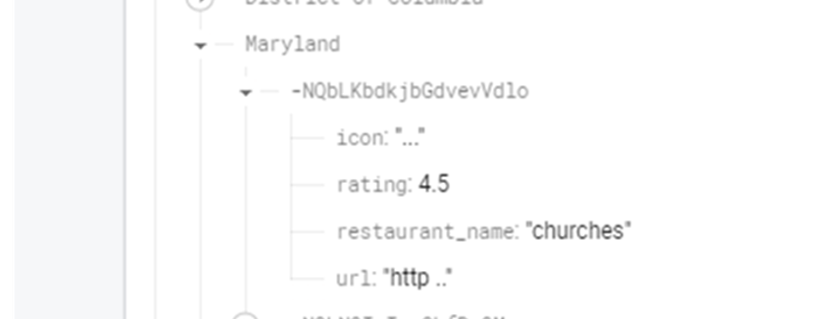
Writing to your Firebase Database
We can also use push(), where Firebase will take care of creating a unique ID under the reference for the data.

Slide 34
Reading from your Firebase Database
To read from the database, we can set up a ValueEventListener, which will be called whenever data at the reference changes.

Slide 35
Reading from your Firebase Database
To read from the database, we can set up a ValueEventListener, which will be called whenever data at the reference changes.
In other words, we can use it to receive a callback whenever a new Yelp is added to a particular state.

Slide 36
Reading from your Firebase Database
A ValueEventListener has both a onCancelled callback and a onDataChange callback.
val reference = firebaseDatabase.getReference(“yelps/$adminArea")
reference.addValueEventListener(object : ValueEventListener {
override fun onCancelled(databaseError: DatabaseError) {
}
override fun onDataChange(dataSnapshot: DataSnapshot) {
}
})

Slide 37
Reading from your Firebase Database
onCancelled gives you a DatabaseError, which you can use to print out the issue.
override fun onCancelled(databaseError: DatabaseError) {
Toast.makeText(
this@TweetsActivity,
"Failed to retrieve yelps! Error: ${databaseError.message}",
Toast.LENGTH_LONG
).show()
}

Slide 38
Reading from your Firebase Database
onDataChange gives you a DataSnapshot, which can you think of as similar to a Map / HashMap (since JSON is structured as key/value pairs).
override fun onDataChange(dataSnapshot: DataSnapshot) {
}

Slide 39
Reading from your Firebase Database
If the data you’re expecting is not a List, you can call getValue(Type::class.java) to have Firebase convert the data to your intended class.
override fun onDataChange(dataSnapshot: DataSnapshot) {
val someString = dataSnapshot.getValue(String::class.java)
// Do something with the data...
}

Slide 40
Reading from your Firebase Database
For custom objects, Firebase mandates that they have an empty / default constructor if we expect to read it the DB.
data class YelpBusiness ( val restaurant_name: String, val category: String, val rating: Double, val icon: String, val url: String ) : Serializable { constructor(): this("","",0.0,"","") }

Slide 41
Reading from your Firebase Database
If the data you’re expecting is a list, you have to iterate through the children and cast each item to the intended class.
override fun onDataChange(snapshot: DataSnapshot) { val yelps= mutableListOf<YelpBusiness>() snapshot.children.forEach{childSnapshot:DataSnapshot -> val yelp: YelpBusiness?=childSnapshot.getValue(YelpBusiness::class.java) if (yelp!=null){ yelps.add(yelp) }

Slide 42
Reading from your Firebase Database
If the data you’re expecting is a list, you have to iterate through the children and cast each item to the intended class.
val yelps= mutableListOf<YelpBusiness>() snapshot.children.forEach{childSnapshot:DataSnapshot -> val yelp: YelpBusiness?=childSnapshot.getValue(YelpBusiness::class.java) if (yelp!=null){ yelps.add(yelp) } }

Slide 43
Reading from your Firebase Database
Another note for lists -- using a ValueEventListener with a list means Firebase will send you the entire list anytime anything changes.

Slide 44
Reading from your Firebase Database
Another note for lists -- using a ValueEventListener with a list means Firebase will send you the entire list anytime anything changes.
To be more efficient, you can use a ChildEventListener which basically only tells you the diffs (item was added, item was removed, etc.)

Slide 45
Reading from your Firebase Database
Though, this will require more logic in your Adapter to handle list diffs.
// Using ChildEventListener is helpful when working with lists
reference.addChildEventListener(object : ChildEventListener {
override fun onCancelled(p0: DatabaseError) { }
override fun onChildMoved(p0: DataSnapshot, p1: String?) { }
override fun onChildChanged(p0: DataSnapshot, p1: String?) { }
override fun onChildAdded(p0: DataSnapshot, p1: String?) { }
override fun onChildRemoved(p0: DataSnapshot) { }
})

Slide 46
Database Security
Firebase uses JSON-based security rules that you can custom-write to manage access and perform data validation.
// User must be logged in and can only read from the portion of the database that’s assigned to their
// user ID (UID).
{
"rules": {
"users": {
"$uid": {
".read": "auth != null && auth.uid == $uid"
}
}
}
}

Slide 47
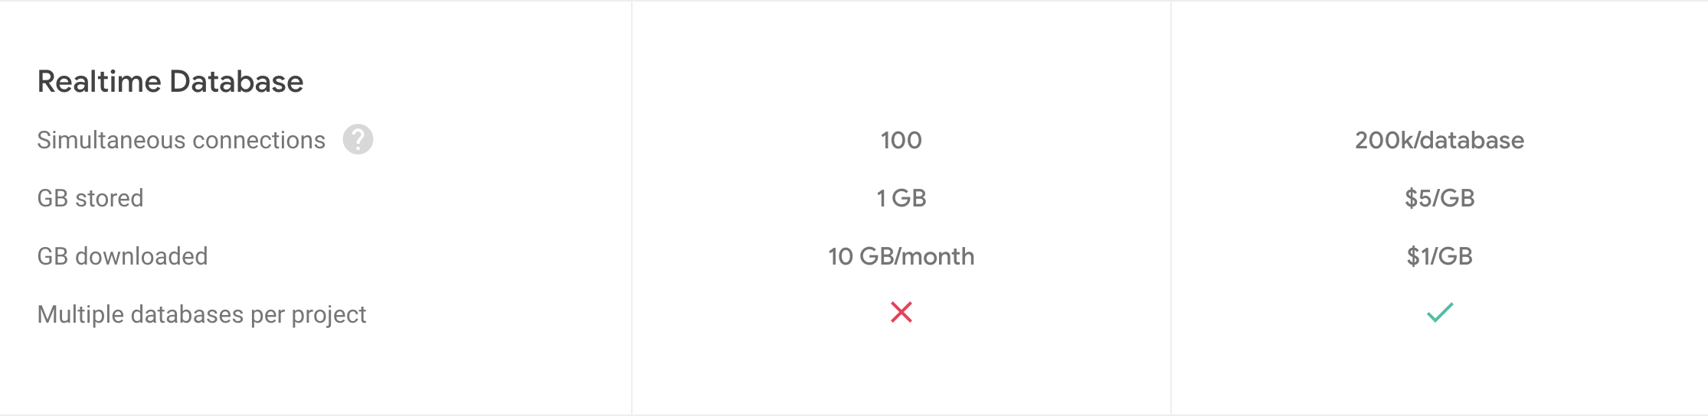
Database Security
The paid-tier for Realtime DB allows you to create multiple databases which you can individually restrict access to.

Slide 48
Firebase
Crashlytics

Slide 49
Crashlytics
When your app is released to the public you need some way to monitor how users are interacting with your app & what problems they are having.

Slide 50
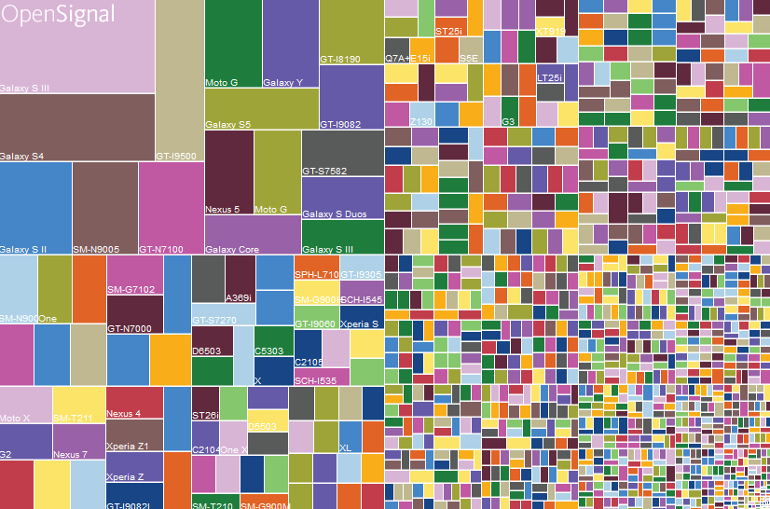
Crashlytics
It’s hard to know how your app will behave across the wide variety of Android devices.

Slide 51
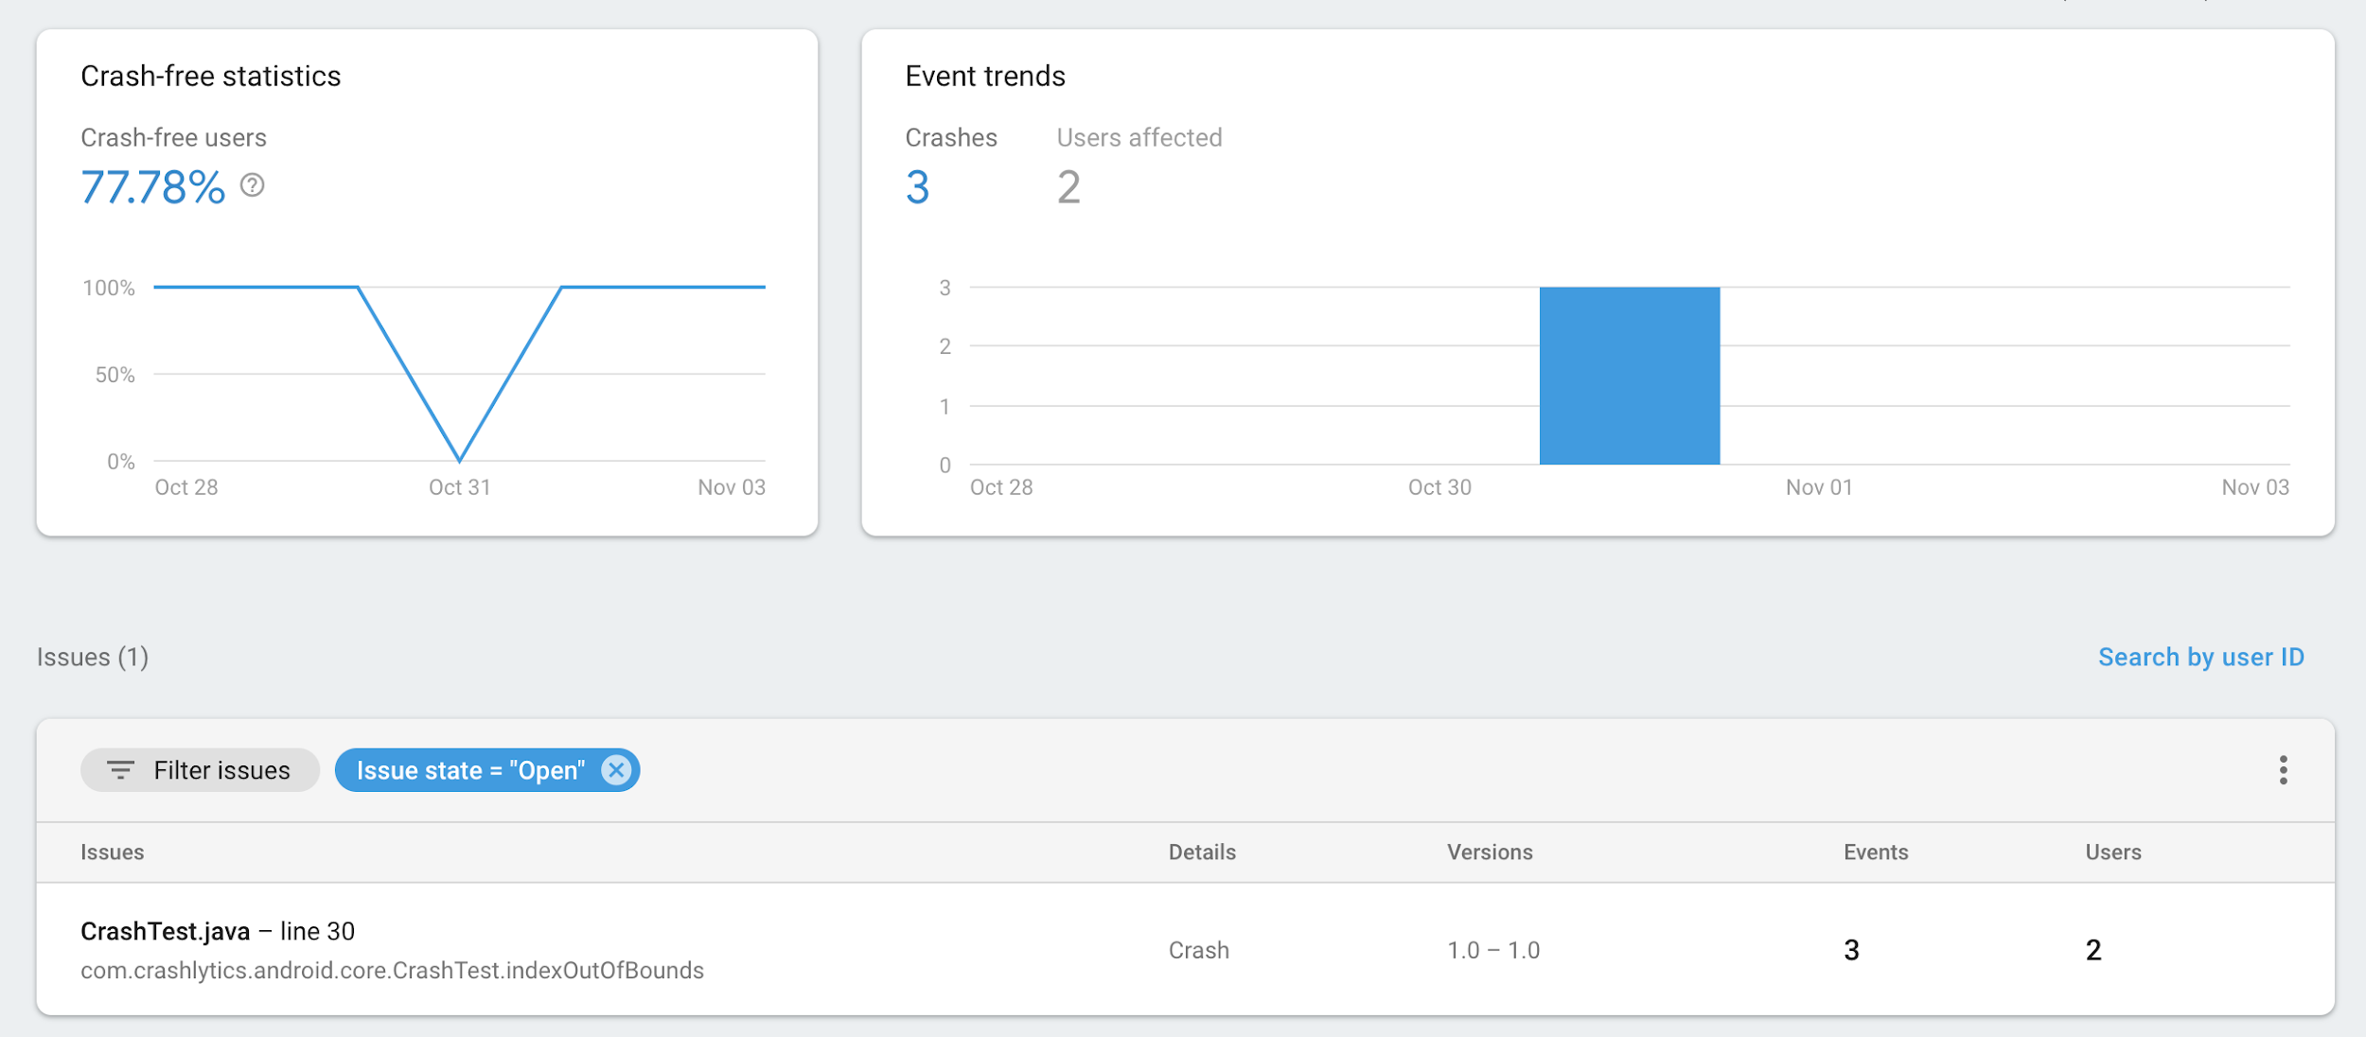
Crashlytics
Firebase Crashlytics -- automatic crash reporting and monitoring.

Slide 52
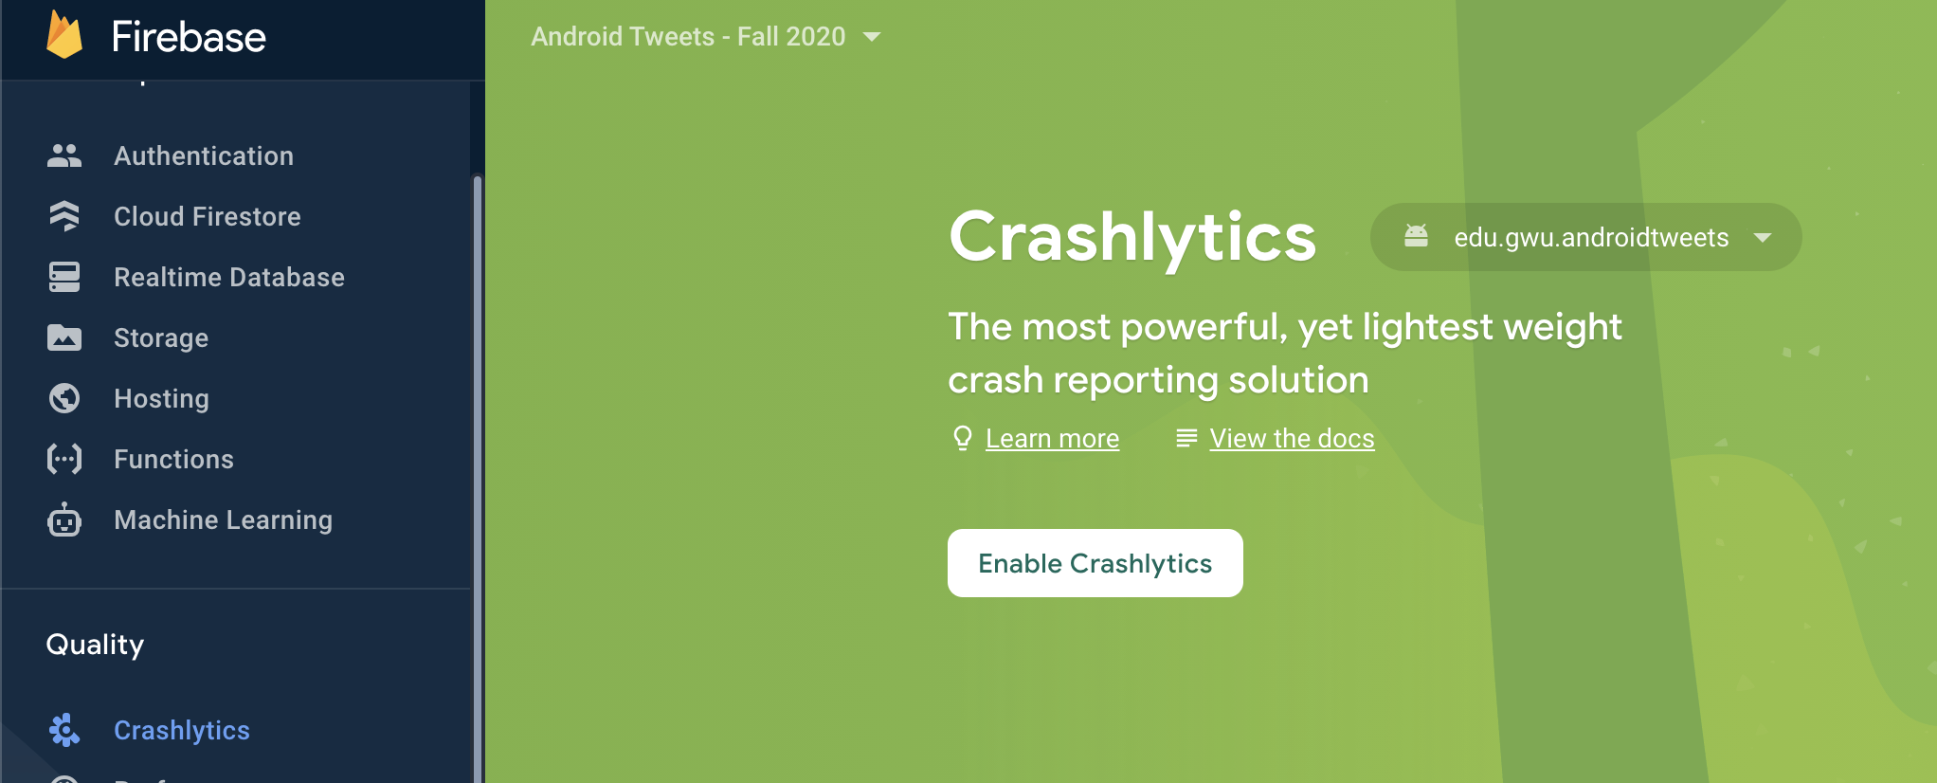
Setting Up Crashlytics

Slide 53
Setting Up Crashlytics
id("com.google.firebase.crashlytics") version "2.9.9" apply false
Project-level build.gradle:
Plugins{
...
id("com.google.firebase.crashlytics") version "2.9.9" apply false
}

Slide 54
Setting Up Crashlytics
App-level build.gradle:
plugins {
...
id 'com.google.firebase.crashlytics'
}
dependencies {
... implementation platform('com.google.firebase:firebase-bom:...')
implementation 'com.google.firebase:firebase-analytics-ktx'
implementation 'com.google.firebase:firebase-crashlytics-ktx'
}

Slide 55
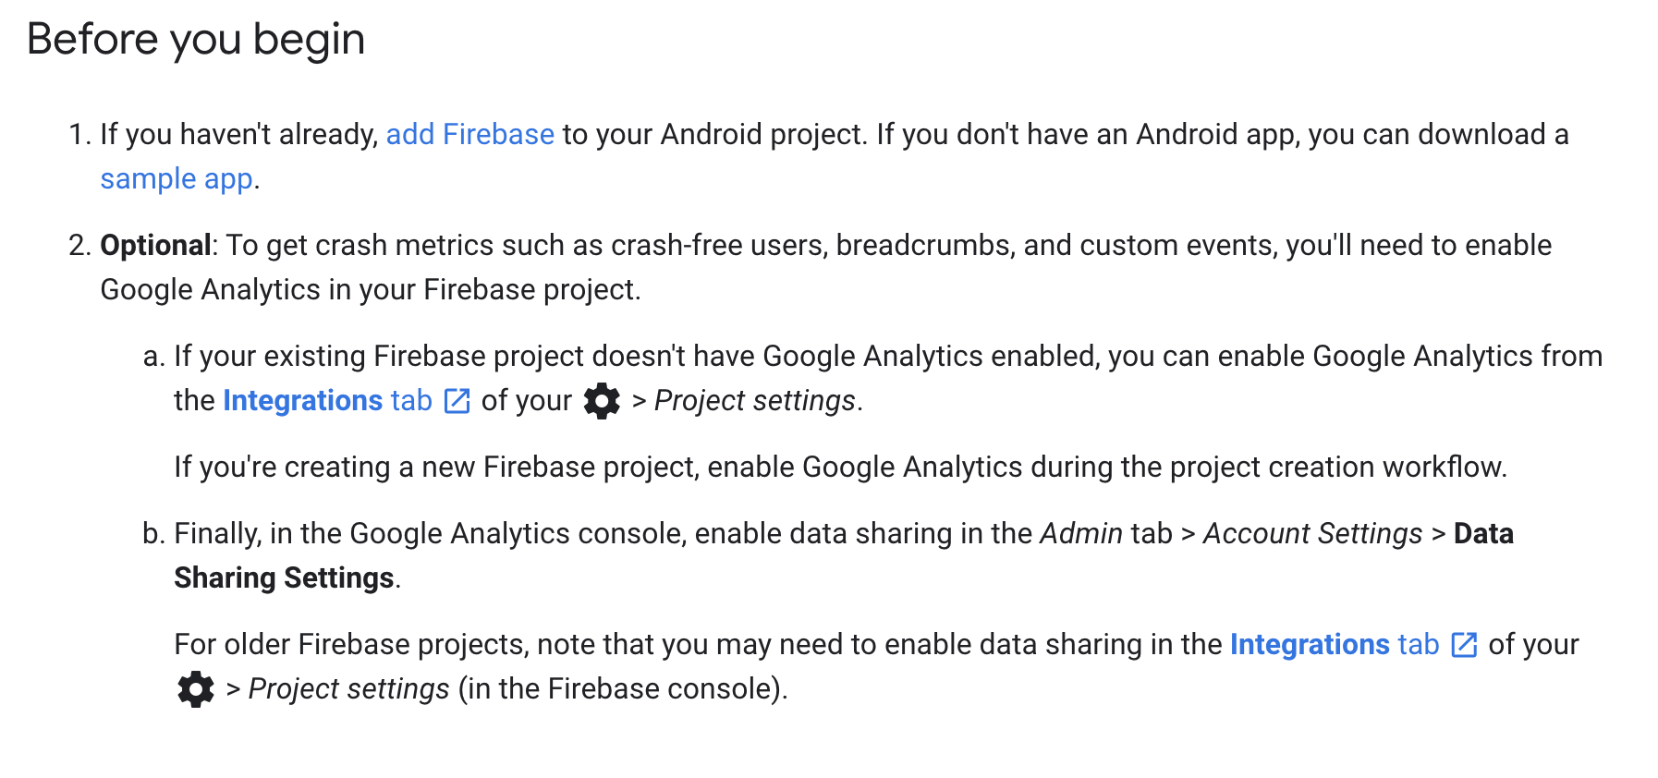
Setting Up Analytics
There’s a couple extra steps which are taken care of automatically if you enable analytics at Firebase project creation.

Slide 56
Setting Up Crashlytics
That’s all you need -- applying the plugin + adding the dependency will cause Crashlytics to be built into your app automatically and will start monitoring in the background.

Slide 57
Setting Up Crashlytics
Testing Crashlytics
Open the app after crashing to make sure the report gets sent.
signUpButton.setOnClickListener {
// Testing that Crashlytics will report properly...
val x = 5 / 0
// ...
}

Slide 58
Setting Up Crashlytics
It may take a few minutes for the first crash data to appear.

Slide 59
Non-Fatal Exceptions
You can also record “non-fatals” -- Exceptions that you catch, but want visibility over.
} catch (exception: Exception) {
// ...
Firebase.crashlytics.recordException(exception)
}

Slide 60
Firebase
Analytics

Slide 61
Analytics
In addition to just crashes, it’s useful to know:
Total users
What screens users spend their time on
What else?

Slide 62
Analytics
In addition to just crashes, it’s useful to know:
Total users
What screens users spend their time on
What else?
New users / acquisition / retention
Daily active users
How often users use your app (e.g. times per day / week / etc.)
...

Slide 63
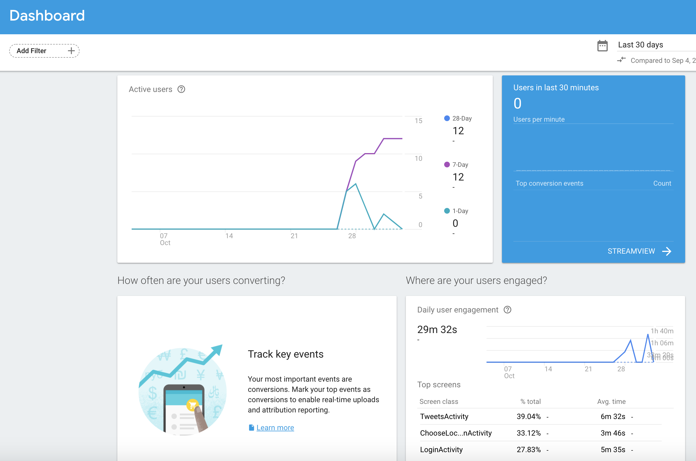
Analytics

Slide 64
Analytics
Firebase (firebase-analytics) automatically captures some analytics for you -- e.g. screens viewed
But things like button click events you need to capture yourself.

Slide 65
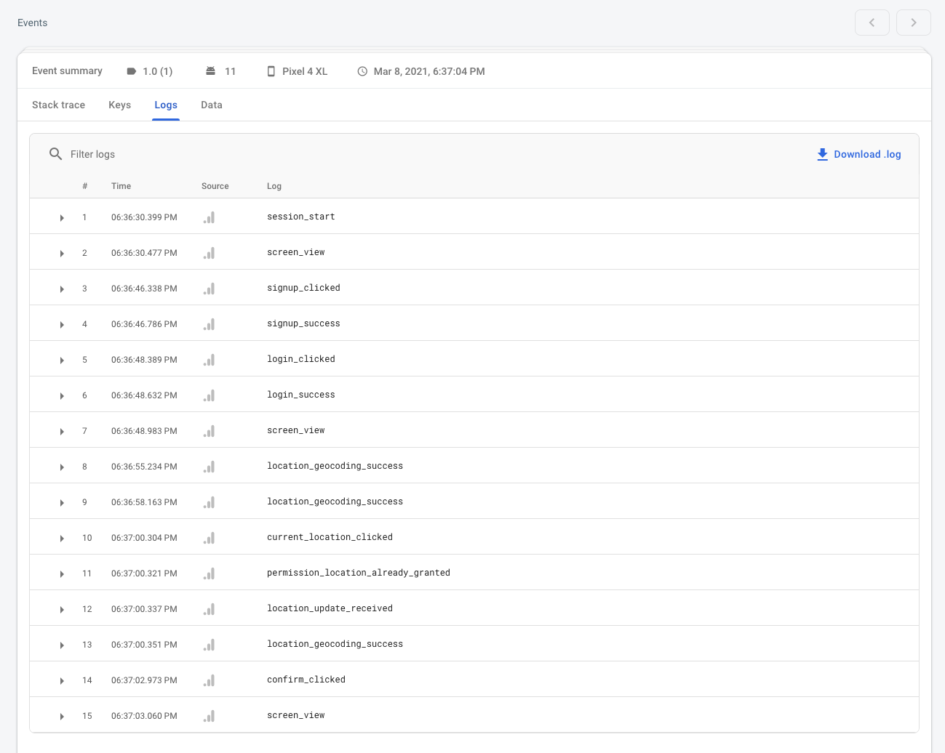
Analytics- breadcrumbs in Crashlytics
It’s also super helpful when debugging a crash to know what the user did leading up to the crash.

Slide 66
Setting Up Analytics
App-level build.gradle (we should have this already):
dependencies {
… implementation platform('com.google.firebase:firebase-bom:...')
implementation 'com.google.firebase:firebase-analytics-ktx'
}

Slide 67
Setting Up Analytics
There’s a couple extra steps which are taken care of automatically if you enable analytics at Firebase project creation.

Slide 68
Basic Usage
Let’s use Firebase Analytics to log some custom events:
Login Activity
Login successful vs. unsuccessful
Maps Activity
Current location button clicked vs. map long press
Tweets Activity
Tweets retrieved successfully vs. unsuccessful

Slide 69
Basic Usage
Get an instance of FirebaseAnalytics
private lateinit var firebaseAnalytics: FirebaseAnalytics
override fun onCreate(savedInstanceState: Bundle?) {
super.onCreate(savedInstanceState)
setContentView(R.layout.activity_login)
firebaseAnalytics = FirebaseAnalytics.getInstance(this)

Slide 70
Basic Usage
Use logEvent(String, Bundle) to log an analytic.

Slide 71
Basic Usage
Use logEvent(String, Bundle) to log an analytic.
First param - the actual analytic (e.g. “login_success” or “current_location_clicked”)

Slide 72
Basic Usage
Use logEvent(String, Bundle) to log an analytic.
First param - the actual analytic (e.g. “login_success” or “current_location_clicked”)
Usually a short, descriptive string.

Slide 73
Basic Usage
Use logEvent(String, Bundle) to log an analytic.
First param - the actual analytic (e.g. “login_success” or “current_location_clicked”)
Second param - key-value pairs to add extra context to your analytic.

Slide 74
Basic Usage
Use logEvent(String, Bundle) to log an analytic.
First param - the actual analytic (e.g. “login_success” or “current_location_clicked”)
Second param - key-value pairs to add extra context to your analytic.
E.g. You might send “login_failed” analytic, but also send the specific error attached to it:

Slide 75
Basic Usage
Use logEvent(String, Bundle) to log an analytic.
First param - the actual analytic (e.g. “login_success” or “current_location_clicked”)
Second param - key-value pairs to add extra context to your analytic.
E.g. You might send “login_failed” analytic, but also send the specific error attached to it:
“error_type” → “invalid credentials”
“error_type” → “failed to connect”
etc.

Slide 76
Basic Usage
Use logEvent(String, Bundle) to log an analytic.
First param - the actual analytic (e.g. “login_success” or “current_location_clicked”)
Second param - key-value pairs to add extra context to your analytic.
Similar to how you would use SharedPreferences or an Intent with data — a Bundle also stores key-value pairs.

Slide 77
Basic Usage
Since we have yet another object that uses key-value pairs:
SharedPreferences - stores key-value pairs to disk. Data can persist between app launches / sessions.

Slide 78
Basic Usage
Since we have yet another object that uses key-value pairs:
SharedPreferences - stores key-value pairs to disk. Data can persist between app launches / sessions.
Intent - stores key-value pairs to pass to another Activity.

Slide 79
Basic Usage
Since we have yet another object that uses key-value pairs:
SharedPreferences - stores key-value pairs to disk. Data can persist between app launches / sessions.
Intent - stores key-value pairs to pass to another Activity.
Bundle - stores key-value pairs for general-purpose usage (similar to a Map). Can be put in an Intent if needed. Also used to support screen rotation (future lecture).

Slide 80
Tracking Login Result
Tracking login success
firebaseAuth.signInWithEmailAndPassword(username, password).addOnCompleteListener { task ->
if (task.isSuccessful) {
firebaseAnalytics.logEvent("login_success", null)

Slide 81
Tracking Login Result
Tracking login failure, with an error type
if (task.isSuccessful) {
// ...
} else {
val exception = task.exception
val reason = if (exception is FirebaseAuthInvalidCredentialsException)
"invalid_credentials" else "failed_to_connect"
val bundle = Bundle()
bundle.putString("error_type", reason)
firebaseAnalytics.logEvent("login_failed", bundle)
}

Slide 82
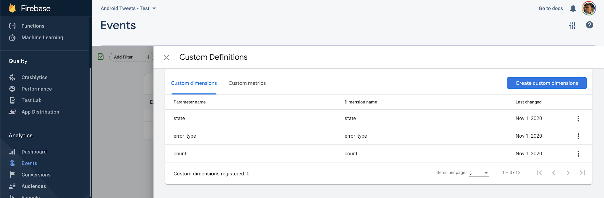
Sending Extra Event Properties
We need to explicitly register extra properties (called “dimensions”) in the dashboard.

Slide 83
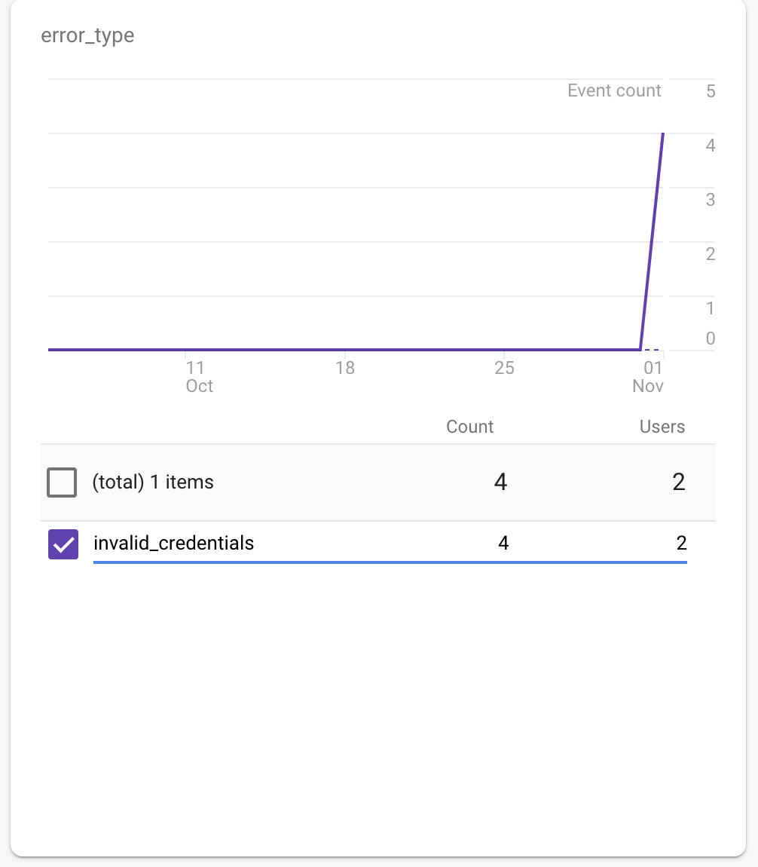
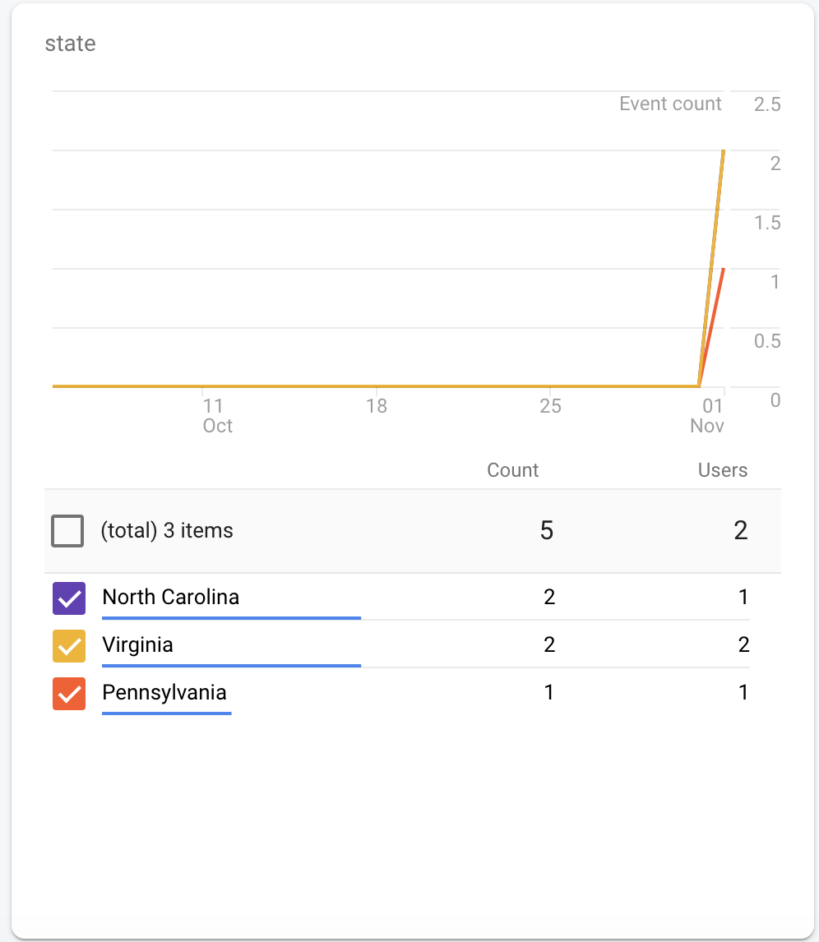
Sending Extra Event Properties

Slide 84
Tracking Login Result
Tracking click events on the maps screen
override fun onCreate(savedInstanceState: Bundle?) {
// …
userLocation.setOnClickListener {
firebaseAnalytics.logEvent("click_current_location", null)
// ...

Slide 85
Tracking Login Result
Tracking click events on the maps screen
override fun onMapReady(googleMap: GoogleMap) {
map = googleMap
map.setOnMapLongClickListener { latLng: LatLng ->
firebaseAnalytics.logEvent("click_map", null)

Slide 86
User Properties
You can also use Firebase Analytics to get an idea of who your users are:
Age / Sex / Location
Language
OS Version
Length of time using the app
Search preferences
etc.

Slide 87
User Properties
These are called “User Properties” and Firebase collects some of this information automatically.
Different types of users may interact with your app differently.

Slide 88
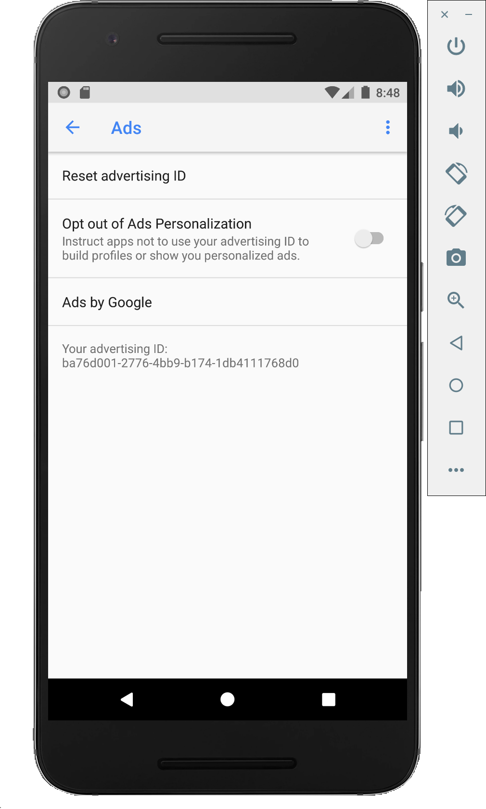
User Properties
Android (and iOS) devices are associated with an “Advertising ID”, which is used to correlate the same device (user) across different services.

Slide 89
User Properties
Android (and iOS) devices are associated with an “Advertising ID”, which is used to correlate the same device (user) across different services.
e.g. ads clicked, searches preferences, etc.
Used to infer user demographics and provide targeted experiences.

Slide 90
User Properties
It’s an opt-out feature (Settings → Google → Ads)
See Firebase’s Documentation “Where Analytics gets demographics, interests, and location data”

Slide 91
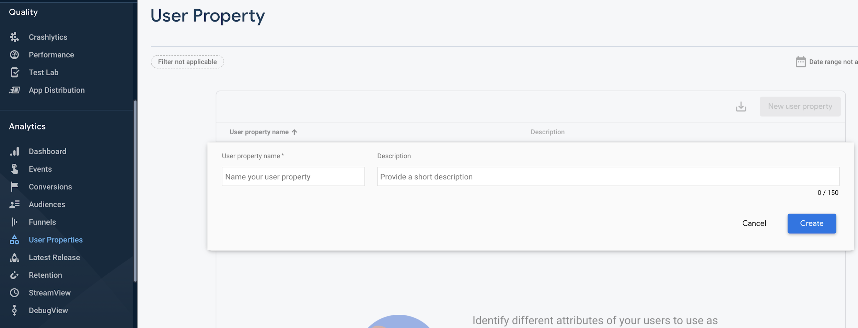
User Properties
Custom user properties can be declared on your dashboard and passed up by your app.

Slide 92
User Properties
You can also track custom user properties by calling setUserProperty(key, value) - both Strings.
firebaseAnalytics.setUserProperty("university", "GWU")
firebaseAnalytics.setUserProperty("major", "Computer Science")
firebaseAnalytics.setUserProperty("level", "Senior")

Slide 93
Delay
Typically, analytics will be loaded into the Firebase dashboard in batches every few hours (e.g. you need to wait to see new analytics appear in the dashboard).

Slide 94
Delay
It may take up to 24 hours for the first analytics data to appear on the dashboard.

Slide 95
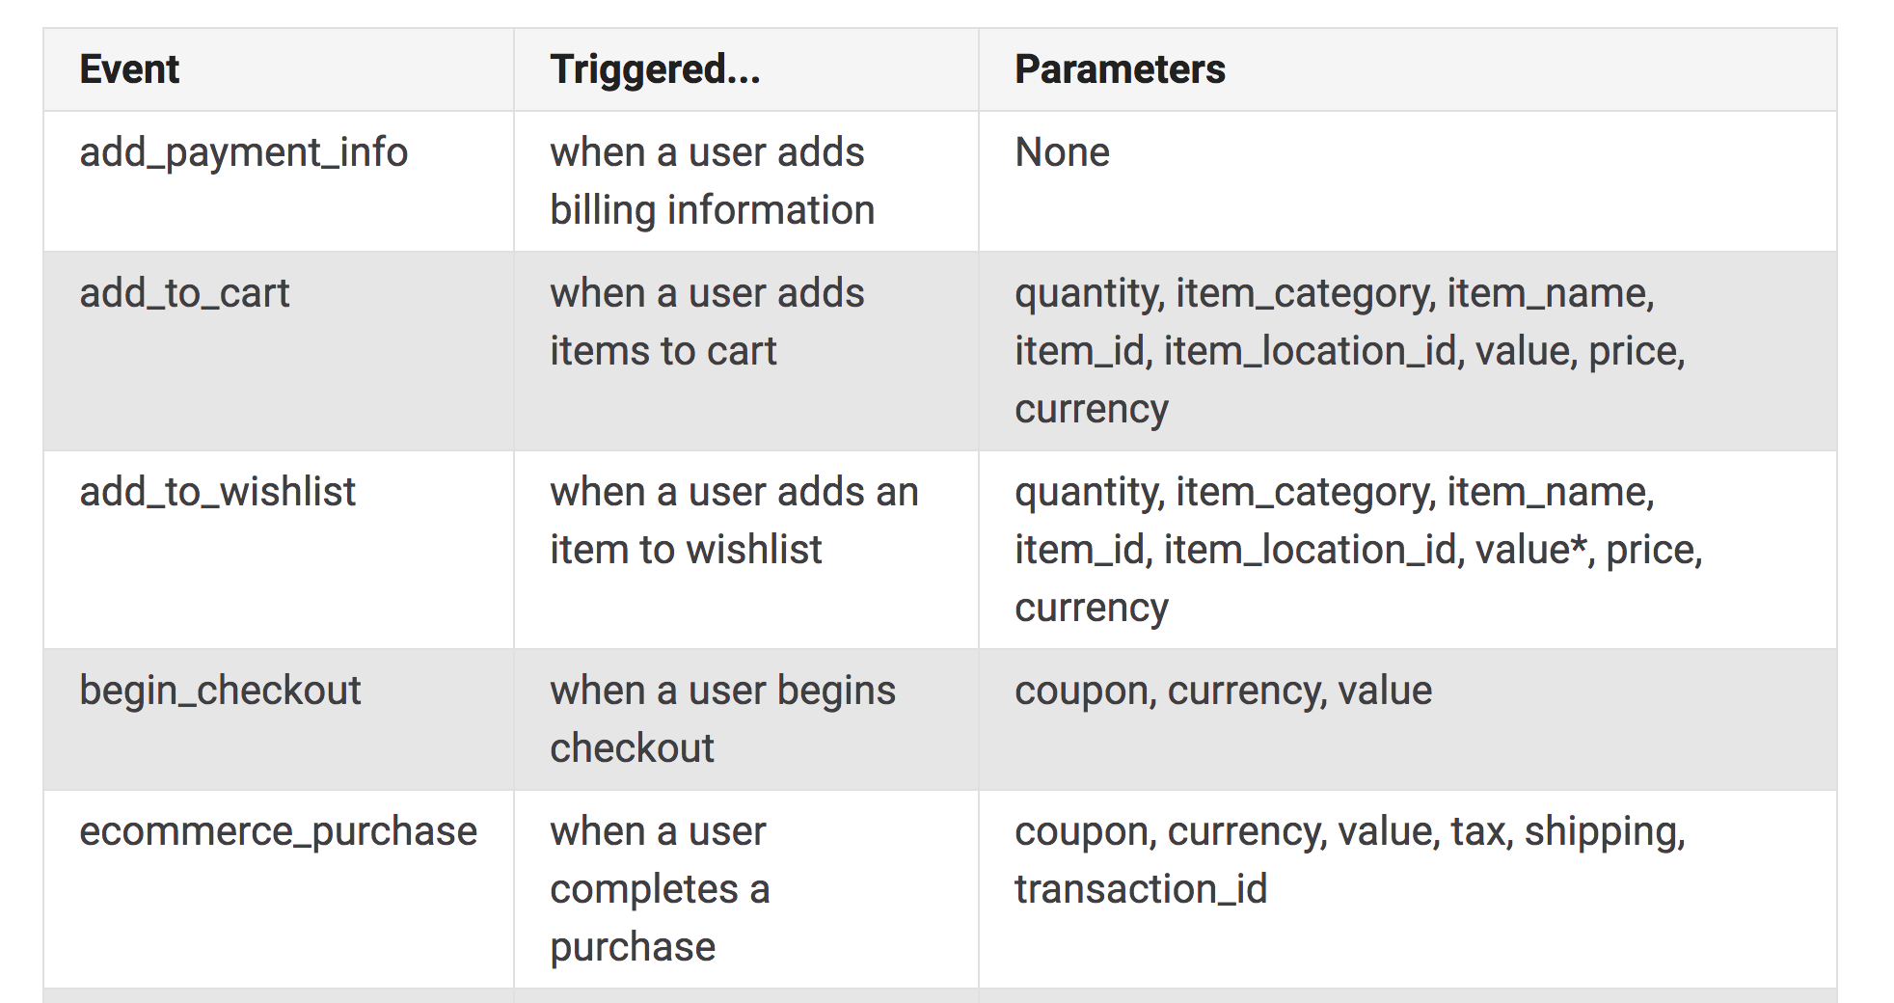
Built-In Events
As mentioned previously, Firebase Analytics has a number of “built-in” analytics that you can send. For example, tracking ecommerce:

Slide 96
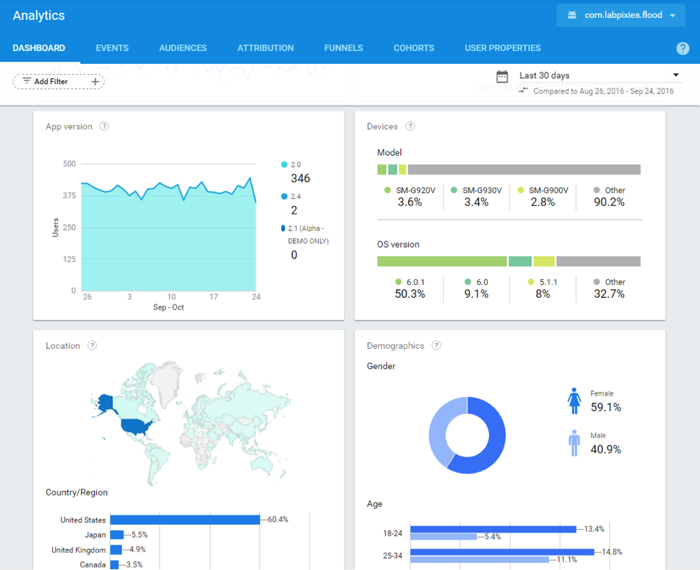
Analytics can be a powerful tool to grow your app!

Slide 97
Questions?

Slide 98
Helpful Links
Firebase
Products
Example Use Cases
Pricing

Slide 99
Helpful Links
Firebase Database
Intro
Basics
JSON Structuring
Reading / Writing
Working with Lists
Configuring Security Rules

Slide 100
Helpful Links
Firebase Crashlytics
Intro
Firebase Analytics
Intro
Logging Events
User Properties

